Slide 1
Population Health Including Patient Supplied Data
By GROUP 6
Suhani Yalaga
Saketha Kusu
Varshitha Devarapalli
Mara Reisingner

Slide 2
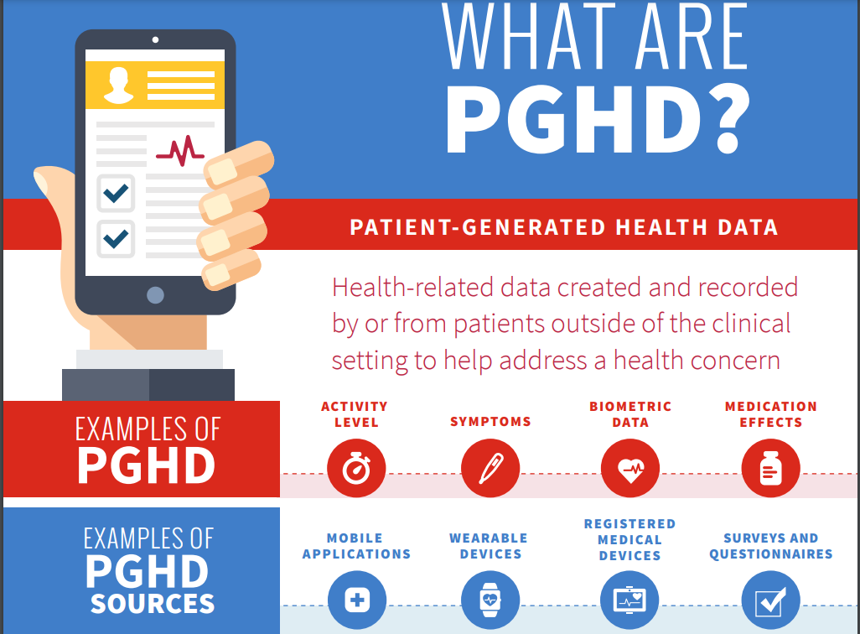
Introduction:
Over view of PGHD:
PGHD, or Patient-Generated Health Data, is information about a person's health and wellness provided directly by the individual. It includes details like health history, treatment records, biometric data, symptoms, and lifestyle choices. Examples of PGHD sources include wearable devices, mobile apps, home health monitors, online portals, and social media. Integrating PGHD into healthcare enables personalized care and a deeper understanding of patient health beyond clinical settings.

Slide 3
Importance of PGHD in Population health management
Personalization of Care: PGHD allows tailoring interventions to individual needs, enhancing patient engagement, adherence, and outcomes.
Early Detection and Prevention: Timely identification of health issues and risk factors enables proactive intervention and preventive measures.
Empowerment of Patients: Involving patients in data collection empowers them to actively manage their health, set goals, and make informed decisions.
Population Health Management: Utilizing PGHD at the population level helps identify health disparities, target interventions, and improve overall health outcomes.
Continuous Improvement: Analysis of patient data enables healthcare organizations to identify areas for improvement and refine population health strategies iteratively.

Slide 4
Goal & Objective
S
SAFE GUARDING PATIENT INTEGRITY
The goal of incorporating Patient-Generated Health Data (PGHD) in safeguarding patient integrity is to enhance patient-centered care and ensure the integrity, privacy, and security of their health information.
MAXIMIZING PROVIDER PATIENT RELATIONSHIP
The goal of maximizing the provider-patient relationship through Patient-Generated Health Data (PGHD) is to enhance communication, trust, and collaboration between healthcare providers and patients, ultimately improving health outcomes and patient satisfaction.
ENCOURAGING PATIENT DATA DONATION
Encourage patient data donation to advance medical knowledge, improve healthcare outcomes, and drive innovation, while simultaneously building trust in the ethical and responsible use of patient-generated health data (PGHD) for clinical care, research, and public health initiatives

Slide 5
Patient Data Collection:
Types of Patient Data
Demographic Information: Name, age, gender, and contact details.
Medical History: Previous illnesses, surgeries, and family medical history.
Clinical Data: Laboratory test results, diagnoses, treatments, and medications.
Biometric Data: Vital signs, such as blood pressure, heart rate, and glucose levels.
Lifestyle Information: Exercise routines, dietary habits, and other health-related behaviors.
Sources of Patient data
1. Electronic Health Records (EHRs)
2. Medical Claims Data
3. Public Health Surveillance Data
4. Wearable Devices
5. Mobile Health Apps
6. Home Health Monitoring Devices
7. Online Portals and Personal Health Records (PHRs)
8. Social Media and Online Health Communities
9. Patient-Reported Outcome Measures (PROMs)
10. Telehealth and Remote Monitoring Platforms
The purpose of patient data collection is to:
1. Provide a comprehensive health overview.
2. Support clinical decision-making.
3. Facilitate research and population health management.
4. Empower patients in healthcare decisions.

Slide 6
Drivers of PGHD
Desire to gain a more holistic and longitudinal view of patients’ health.
Increased care coordination for chronic conditions.
Regulations that incent the capture and use of data from non-clinical settings.

Slide 7
Benefits of patient generated health data
Complements existing clinical data by offering a holistic view of patient health.
Responsibility for capturing data lies with patients, enhancing autonomy.
Facilitates shared decision-making and management of chronic conditions.
Offers insight into health status between medical appointments.
Potential for cost savings and improvements in care coordination and patient safety.
Enables early detection of health issues and deviations from treatment plans.
Empowers patients to actively engage in healthcare management.
Accelerates research efforts by providing access to real-time patient data.
Promotes personalized medicine approaches tailored to individual patient needs.

Slide 8
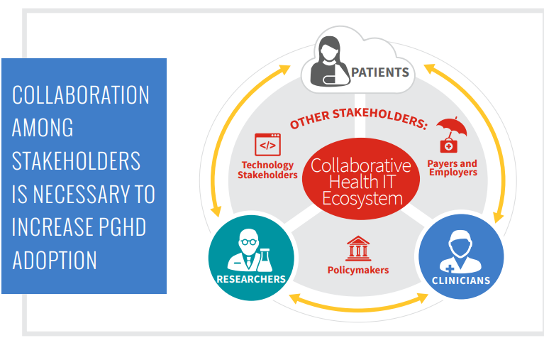

Slide 9
Challengess:
Patient Engagement: Some patients may not understand the benefits of PGHD, leading to limited involvement.
Infrastructure and Workflow Constraints: Healthcare systems lack necessary technical infrastructure and workflows for PGHD integration.
Workload and Workflow Interruptions: Healthcare professionals fear increased workload and disruptions without clear guidelines for PGHD integration.
Data and Device Challenges: High device abandonment rates and data standardization issues pose obstacles to PGHD utilization.
Concerns about accuracy, security risks, and liability further complicate PGHD implementation efforts.

Slide 10
Strategies for implementation
Successful integration of patient-provided data into public health management relies on strong information governance frameworks, cross-sector collaboration in healthcare, and the development of data analytics capabilities. Engaging patients in the data collection process and addressing ethical considerations, such as privacy and consent, are essential strategies for ensuring successful implementation.

Slide 11
Security and Privacy Concerns:
PGHD lacks consistent legal and regulatory frameworks, making it vulnerable to security breaches and unauthorized access.
Vulnerabilities:
Insecure data collection points and data movement increase the risk of exposure to malware and other pollutants.
Addressing Concerns:
Ongoing security risk assessments and management are necessary to mitigate risks and enhance resilience against security breaches.
Ethical Considerations:
Respecting patient autonomy, obtaining informed consent, and adhering to ethical guidelines are essential for safeguarding privacy and information security.

Slide 12
Future Directions
In the future, emerging technologies like AI and ML will optimize the use of patient-provided data (PGHD) in population health management. AI and ML can swiftly analyze vast datasets, providing deeper insights and enabling tailored interventions. Addressing disparities through data-driven approaches and collaboration with diverse stakeholders will be crucial for improving population health outcomes. Overall, the future of PGHD holds promise for enhancing health outcomes and promoting equity across communities.

Slide 13
Conclusion
In conclusion, integrating patient-provided data (PGHD) is vital for advancing population health management. It broadens healthcare capacity, optimizes care, and fosters personalized health approaches. Challenges like patient engagement and security concerns must be addressed, requiring stakeholder collaboration. As AI and ML technologies evolve, PGHD's future promises improved health outcomes and enhanced healthcare practices.

Slide 14
References:
1)https://www.ncbi.nlm.nih.gov/pmc/articles/PMC8733917/
2) Wells, T. S., Ozminkowski, R. J., Hawkins, K., Bhattarai, G. R., & Armstrong, D. G. (2016, July 3). Leveraging big data in population health management. Big Data Analytics. https://doi.org/10.1186/s41044-016-0001-5.
4)Bresnick, J. (2019, June 18). Which Healthcare Data is Important for Population Health Management? HealthITAnalytics.
5)https://healthitanalytics.com/news/which-healthcare-data-is-important-for-population-health-management
6)“Patient-Generated Health Data and Its Impact on Health Information Management,” Healthport, October 2015, https://www.healthport.com/docs/default source/whitepapers/wp_patientgeneratedhealthdata_120415_web.pdf?sfvrsn=2.
7) Doyle-Lindrud S. The evolution of the electronic health record. Clin J Oncol Nurs. 2015;19(2):153–4.
8) Patient-Generated Health Data | HealthIT.gov. (n.d.). https://www.healthit.gov/topic/scientific-initiatives/pcor/patient-generated-health-data-pghd

